Slide 1
Battle of neighborhood
-Sehajdeep singh

Slide 2
Objective
To explore food place around Winnipeg.
Give International students a tool of food places around Red River College.

Slide 3
Tools AND Libraries used
Foresquare API
Pandas
Numpy
BeautifulSoap
Jupiter Notebooks
Git

Slide 4
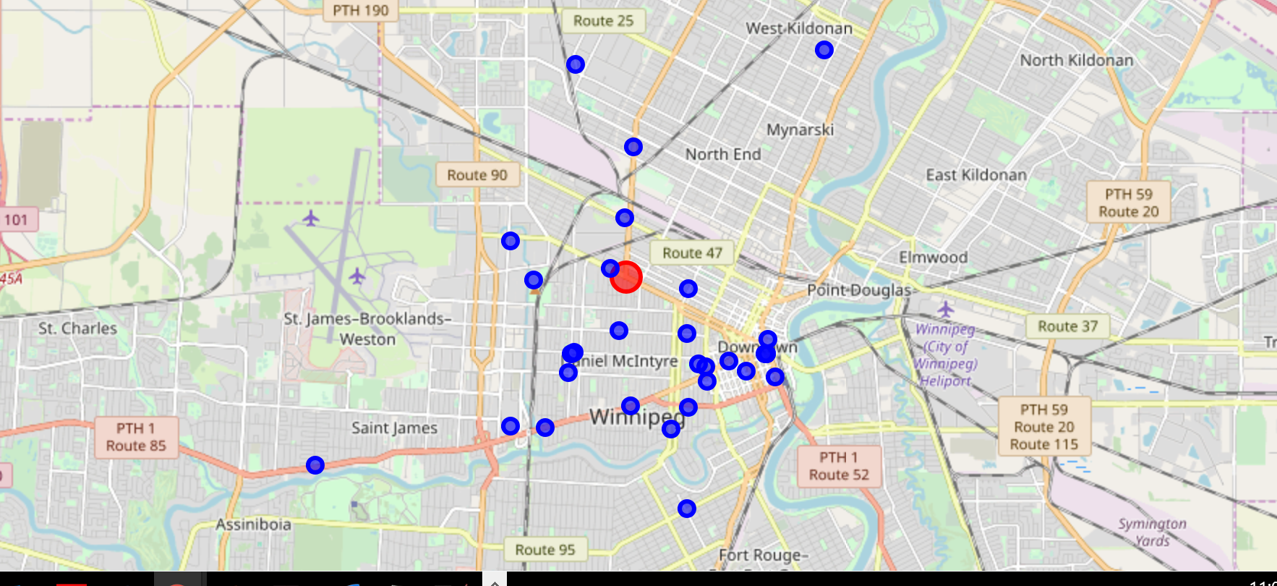
result

Slide 5
conclusion
The red marker on the map represents the Red River College and blue markers are the food joints within 5 Kms radius around the same.

